Slide 1



Supporting Your Child with Phonics: Read Write Inc. in Year 1 & Year 2
Henry Chadwick Primary School
12th October 2026
Parent Workshop

Slide 2
Welcome to Our Phonics Workshop
Purpose:
  Understanding how we teach phonics and how parents can help at home.
  Understanding how to support your child with the Year 1 Phonics Screening Check.

Slide 3
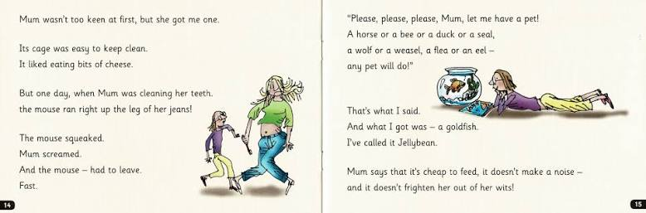
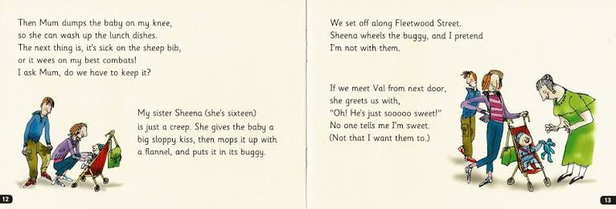
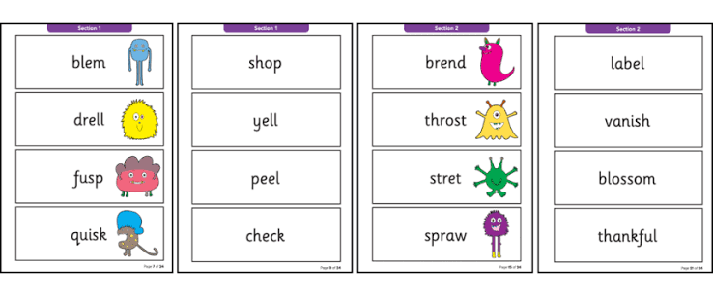
End of Year 1 Expectations!

Slide 4
What is Phonics?
A method for teaching children to read and write.
Focus on sounds (phonemes) and how they are written (graphemes).
Essential for early reading and spelling.

Slide 5
What Is Read Write Inc. (RWI)?
A structured, synthetic phonics programme.
Designed by Ruth Miskin.
Used in schools across the UK.
Teaches children to:
  Recognise sounds
  Blend sounds to read
  Segment words to spell
  Develop comprehension

Slide 6
What Does a Year 1 RWI Lesson Look Like?​
Fast-paced Interactive Structured
1. Revisit Sounds​
• Speed Sounds review​
• Fred Talk practice​
• Quick recall activities​
2. Learn & Practise​
• New sound or spelling​
• Partner work​
• Reading words and sentences
3. Read the Story​
• Group reading​
• Fluency and expression​
• Comprehension question
Children are actively involved throughout the lesson, reading, talking and responding together to build confidence, accuracy and fluency.

Slide 7
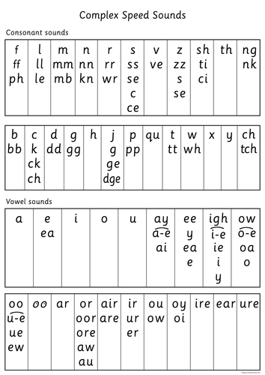


What Does a Year 2 RWI Lesson Look Like?​
1. Speedy Sounds & Review​
• Quick recall of complex sounds​
• Read words at speed​
• Practise spelling patterns​
2. Reading with Fluency​
• Partner reading​
• Accurate and expressive reading​
• Vocabulary discussion​
3. Comprehension & Writing​
• Answer questions about the text​
• Discuss vocabulary and meaning​
• Short spelling or writing
Building fluency, comprehension and confident readers​

Slide 8

Sound Pronunciation
Importance of pure sounds (e.g., "mmmm" not "muh")
Here’s Sylvie showing us how it’s done!

Slide 9

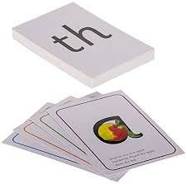
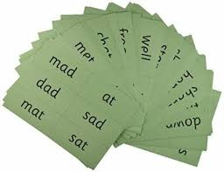
What Does a Lesson Look Like?
Review previous sounds
Introduce new sound
Practise reading and writing the sound
Use of "Fred Talk" for blending (e.g., “ch-air")
Reading words and short sentences
Writing words and sentences
Partner reading

Slide 10

Year 1 Phonics Screening Check (PSC)
What is the PSC?
• A short national check taken by all Year 1 children in June
• Assesses children's phonics decoding skills
• Children read 40 words: real words and nonsense ('alien') words
What will my child do?
• Read words one-to-one with a familiar adult
• Use their phonics knowledge to decode unfamiliar words
• Complete the check in around 5–10 minutes
How can parents help? Read regularly at home, practise Speed Sounds,
and encourage children to use Fred Talk to decode unfamiliar words.

Slide 12
Key Vocabulary
Phoneme: a sound
Grapheme: a letter or group of letters that represents a sound
Blending: putting sounds together to read a word
Segmenting: breaking a word into sounds to spell
Fred Talk: saying each sound in a word to blend it

Slide 13
How We Assess Progress
Ongoing daily observations
Half-termly assessments to group children
Children move at their own pace

Slide 14


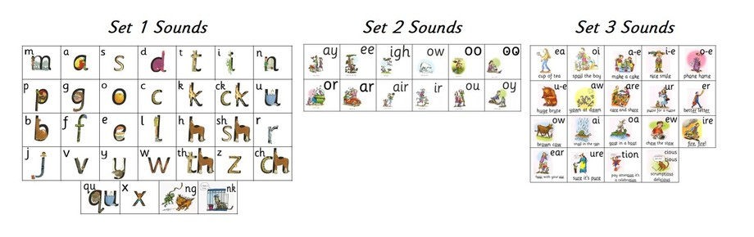
How You Can Help at Home
Watch sound pronunciation videos
Read daily with your child
Encourage ‘Fred Talk’ when reading unknown words
Read nonsense (alien) words
Celebrate effort and progress

Slide 15
Final Tips
Keep it fun and pressure-free
Short daily practise is best
Talk, read and play with language daily
Praise their efforts!

Slide 16
Thank You for listening, now let’s go and see phonics in action in Key Stage 1.
Any questions?

